Slide 1
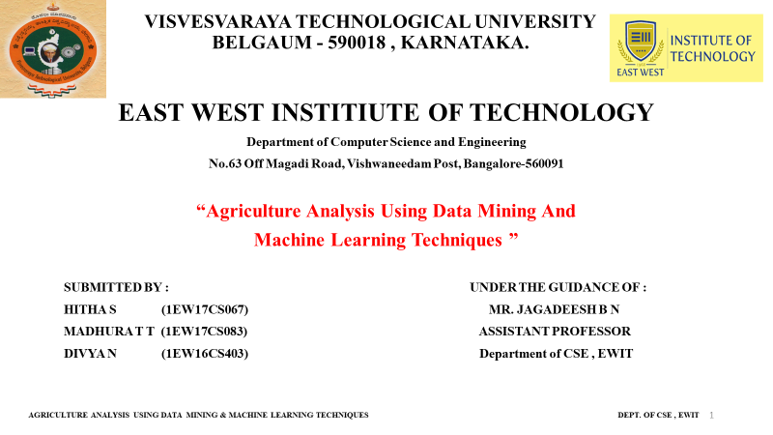
WEB TECHNOLOGY MINI PROJECT PRESENTATION ON
“ ONLINE NOTICE BOARD ”
SUBMITTED BY : UNDER THE GUIDANCE OF :
HITHA S (1EW17CS067) MR. KIRAN M
MADHURA T T (1EW17CS083) ASSOCIATE PROFESSOR
Department of CSE, EWIT.

Slide 2
CONTENTS
ABSTRACT
INTRODUCTION
SOFTWARE AND HARDWARE REQUIREMENTS
IMPLEMENTATION DETAILS
SKILLS UTILIZED
OUTCOME
PROJECT OUTPUT SNAPSHOTS
CONCLUSION

Slide 3
ABSTRACT
The Online Notice Board Project is an application which will automate a lot of activities in an institution or an organization .
It makes information dissemination much easier in a paperless community as the world is transforming into a digital world with the online notice board facility.

Slide 4
INTRODUCTION
An online notice board is a place where people can leave any types of messages and notifications, for example, to advertise things, announce events or provide any information.
Online Notice Board can be made available on digital platforms such computers, tabs, mobile phones etc.
In Online Notice Board , Admin can send the notification to the particular students regarding results, any new activity happen in college campus or college fest participation, warnings and reminders etc. making the work much easier and understandable to all.

Slide 5
SOFTWARE / HARDWARE TOOLS DETAILS
Tools & Technologies Used
HTML : HTML is a markup language for describing web documents (web pages).
CSS : CSS is a style sheet language that describes the presentation of an HTML (or XML) document. CSS describes how elements must be rendered on screen, on paper, or in other media.
PHP :The PHP stands for Hypertext Preprocessor (PHP), is a programming language that allows web developers to create dynamic content that interacts with databases. PHP is basically used for developing web based software applications. This document helps programmer to build system base with PHP.
MySQL : MySQL is the most popular Open Source Relational SQL database management system. MySQL is one of the best RDBMS being used for developing web-based software applications. MySQL is a fast, easy-to-use RDBMS being used for many small and big businesses. MySQL is developed, marketed, and supported by MySQL AB, which is a Swedish company.
jQuery : jQuery is a lightweight, "write less, do more", JavaScript library. The purpose of jQuery is to make it much easier to use JavaScript on system website. jQuery takes a lot of common tasks that require many lines of JavaScript code to accomplish, and wraps them into methods that programmer can call with a single line of code. jQuery also simplifies a lot of the complicated things from JavaScript, like AJAX calls and DOM manipulation.

Slide 6
SOFTWARE / HARDWARE TOOLS DETAILS
Bootstrap :
Bootstrap is the most popular HTML, CSS, and JavaScript framework for developing responsive, mobile-first web sites. Bootstrap is completely free to download and use and also an open-source collection of tools for creating websites and web applications. It contains HTML- and CSS-based design templates for typography, forms, buttons, navigation and other interface components, as well as optional JavaScript extensions. It aims to ease the development of dynamic websites and web applications.
Bootstrap is a front end framework, that is, an interface for the user, unlike the server-side code which resides on the "back end" or server. Bootstrap is compatible with the latest versions of the Google Chrome, Firefox, Internet Explorer, Opera, and Safari browsers, although some of these browsers are not supported on all platforms.
Since version 2.0 it also supports responsive design this means the layout of web pages adjusts dynamically, taking into account the characteristics of the device used (desktop, tablet, mobile phone). Starting with version 3.0, Bootstrap adopted a mobile design philosophy, emphasizing responsive design by default.
Bootstrap provides bootstrap CSS, bootstrap layouts and bootstrap plugins for effective design.

Slide 7
SOFTWARE / HARDWARE TOOLS DETAILS
XAMPP Server
Sublime Text Editor
Firefox Web Browser

Slide 8
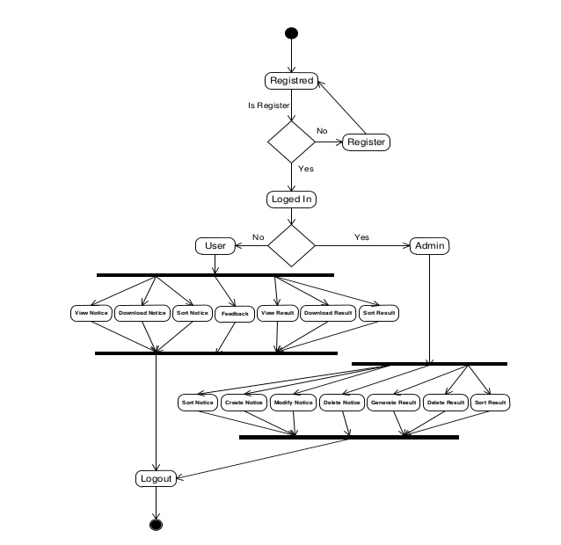
IMPLEMENTATION DETAILS

Slide 9
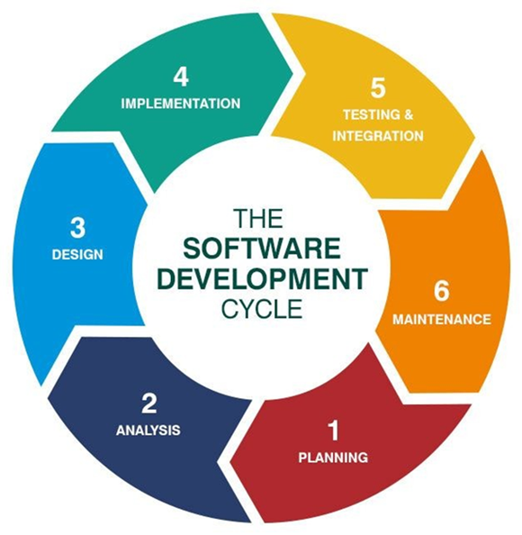
SKILLS UTILIZED

Slide 10
PROJECT OUTCOME
WHAT WE HAVE LEARNT IN THE PROCESS ?
TECHNICAL SKILLS :
SOFT SKILLS :
MANAGEMENT SKILLS :
Implementing HTML , CSS , JScript
Latest trends and updates , requirements.
Bootstrap framework
Teamwork in an working environment.
Communication skills
Design and Working culture.
Project Management
Time Management

Slide 11
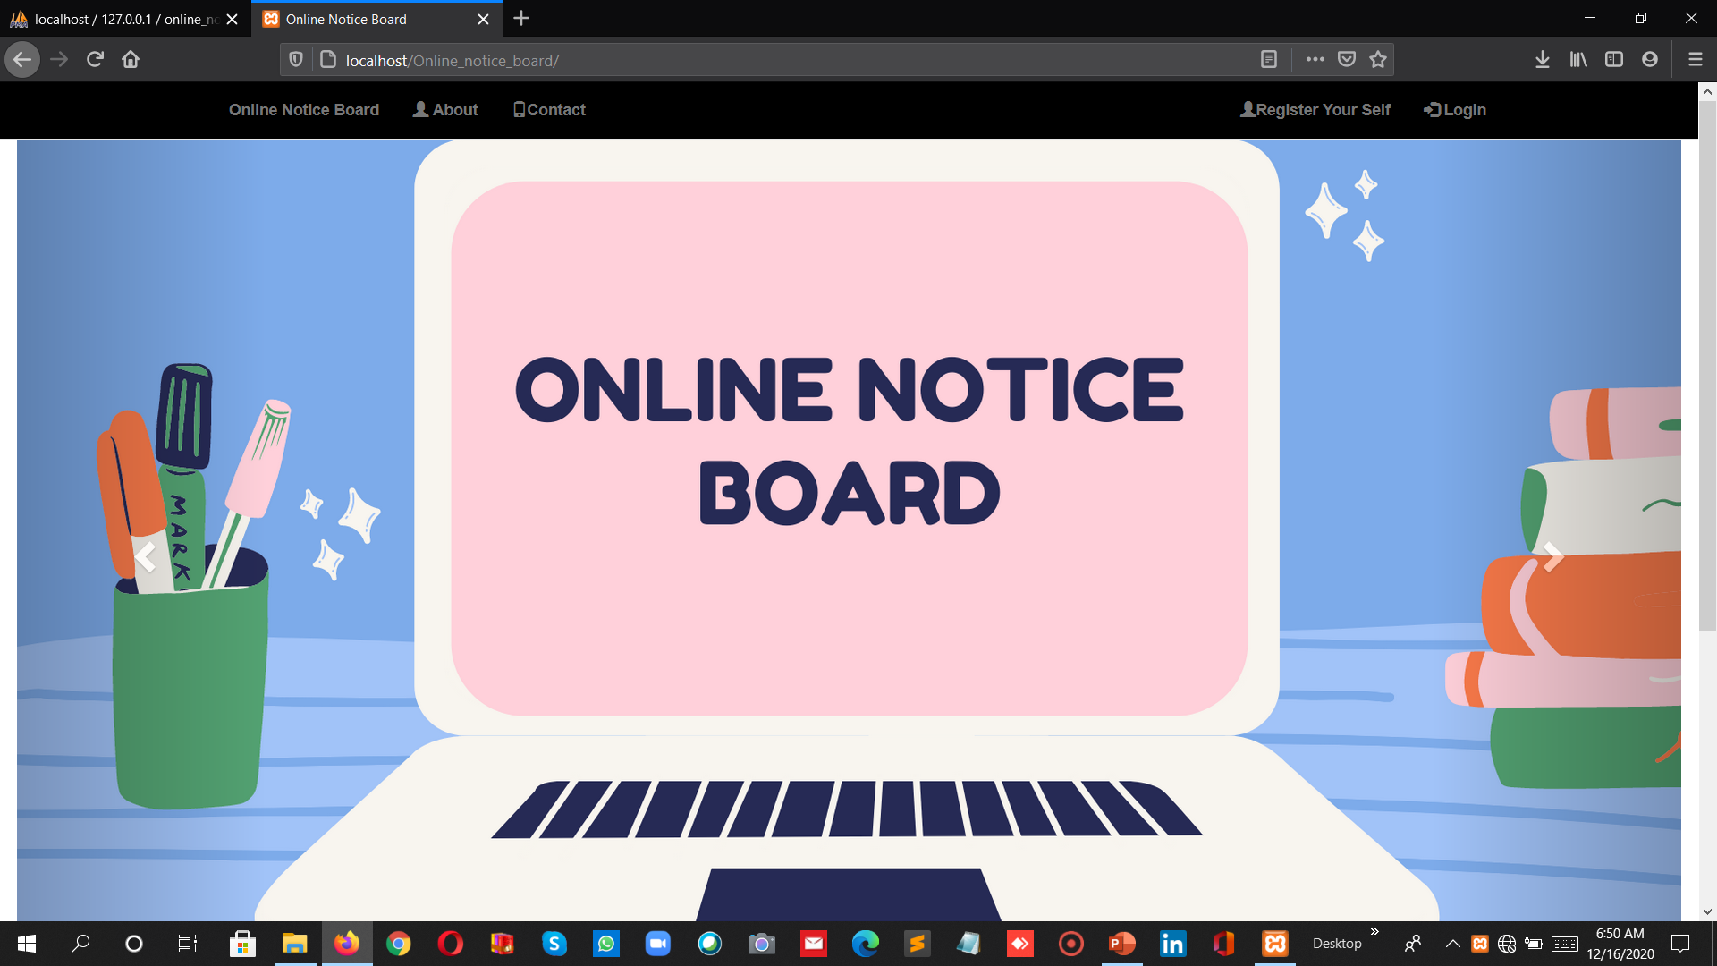
PROJECT SNAPSHOTS - HOME PAGE

Slide 12
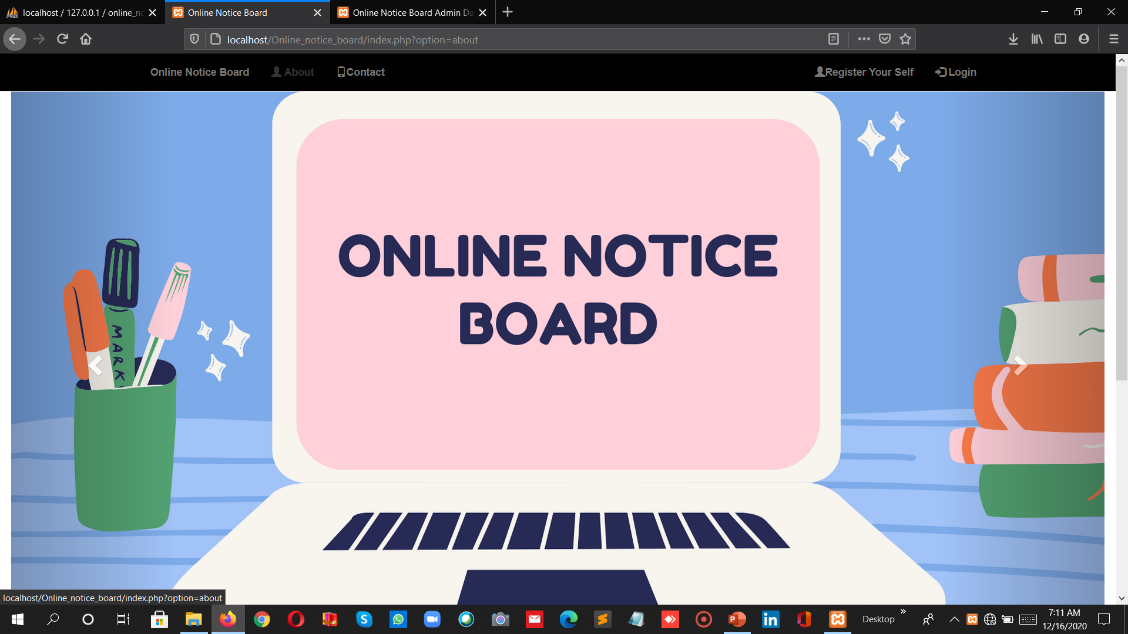
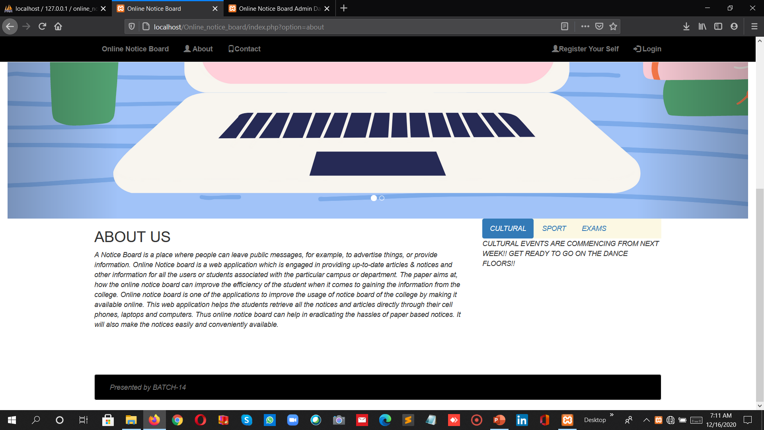
PROJECT SNAPSHOT – ABOUT PAGE

Slide 13
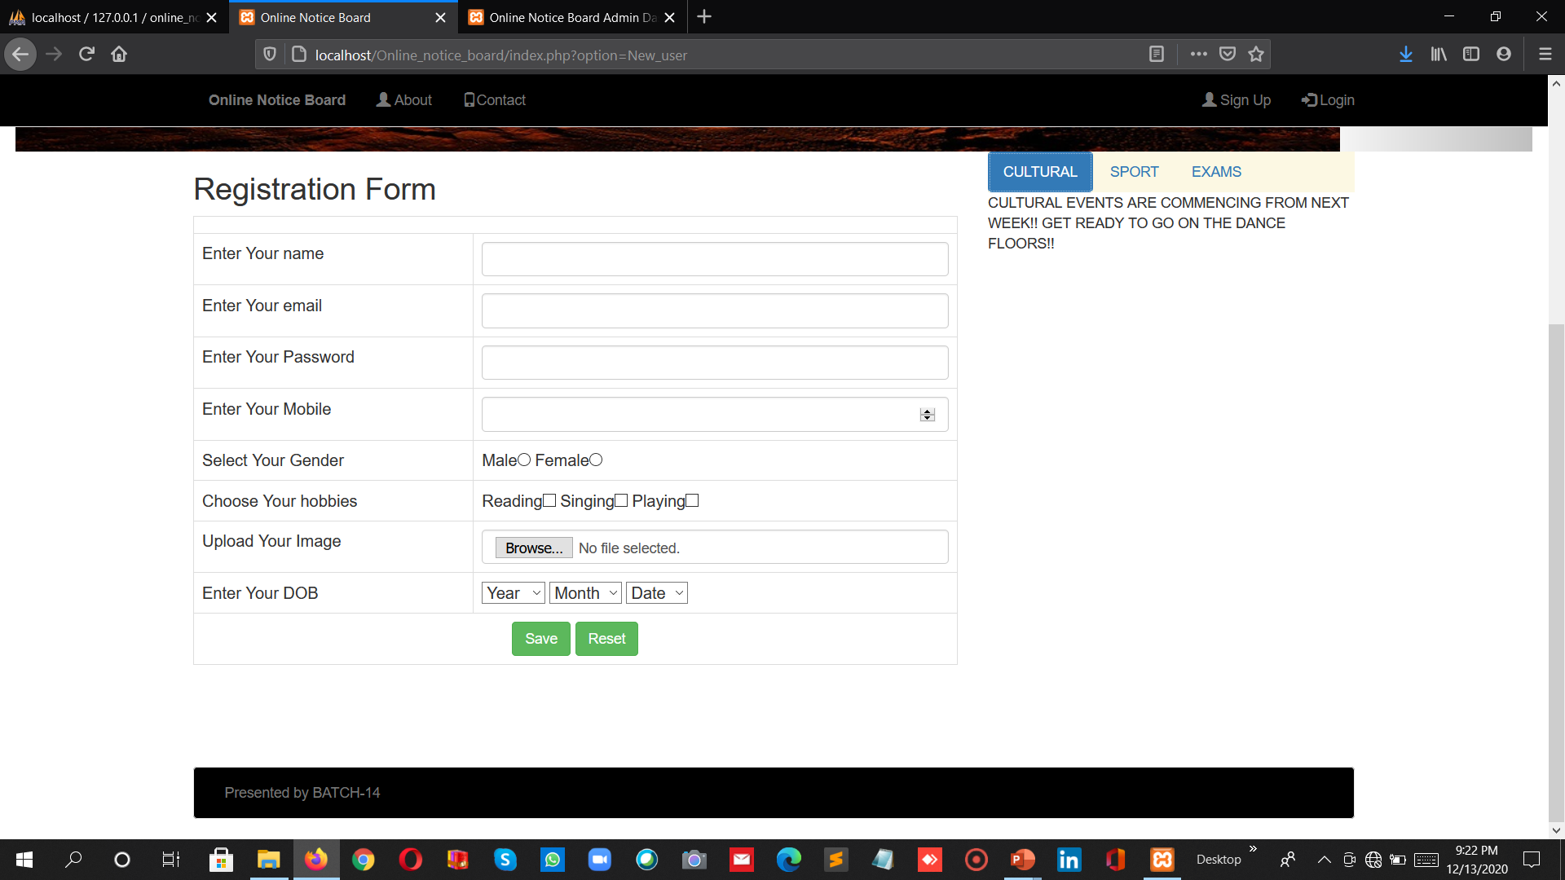
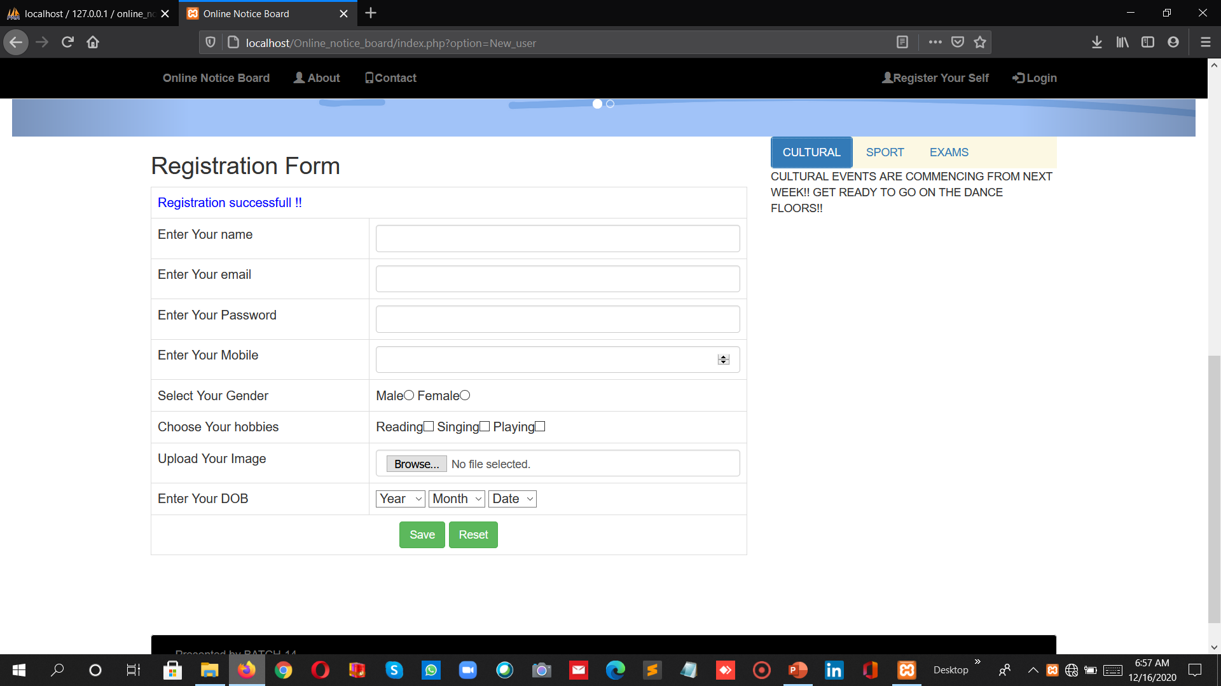
PROJECT SNAPSHOT – REGISTRATION FORM
REGISTRATION FORM

Slide 14
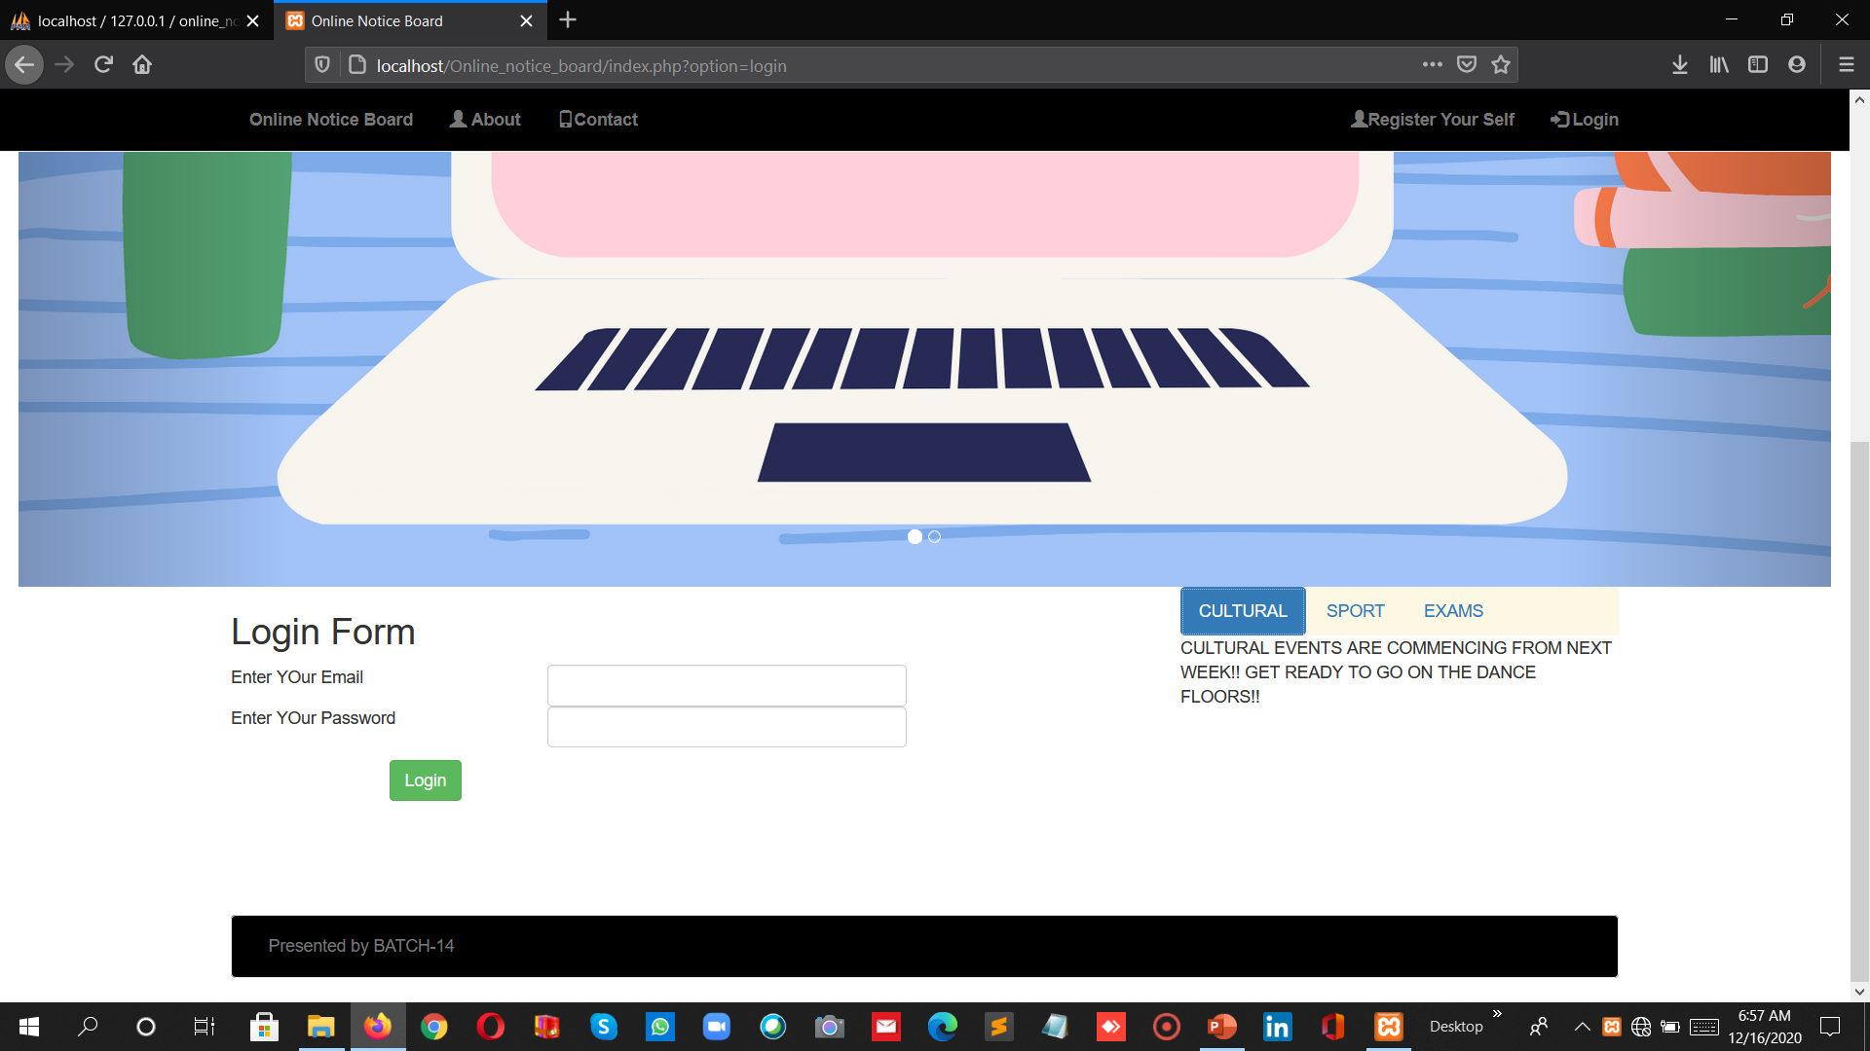
PROJECT SNAPSHOT – LOGIN FORM

Slide 15
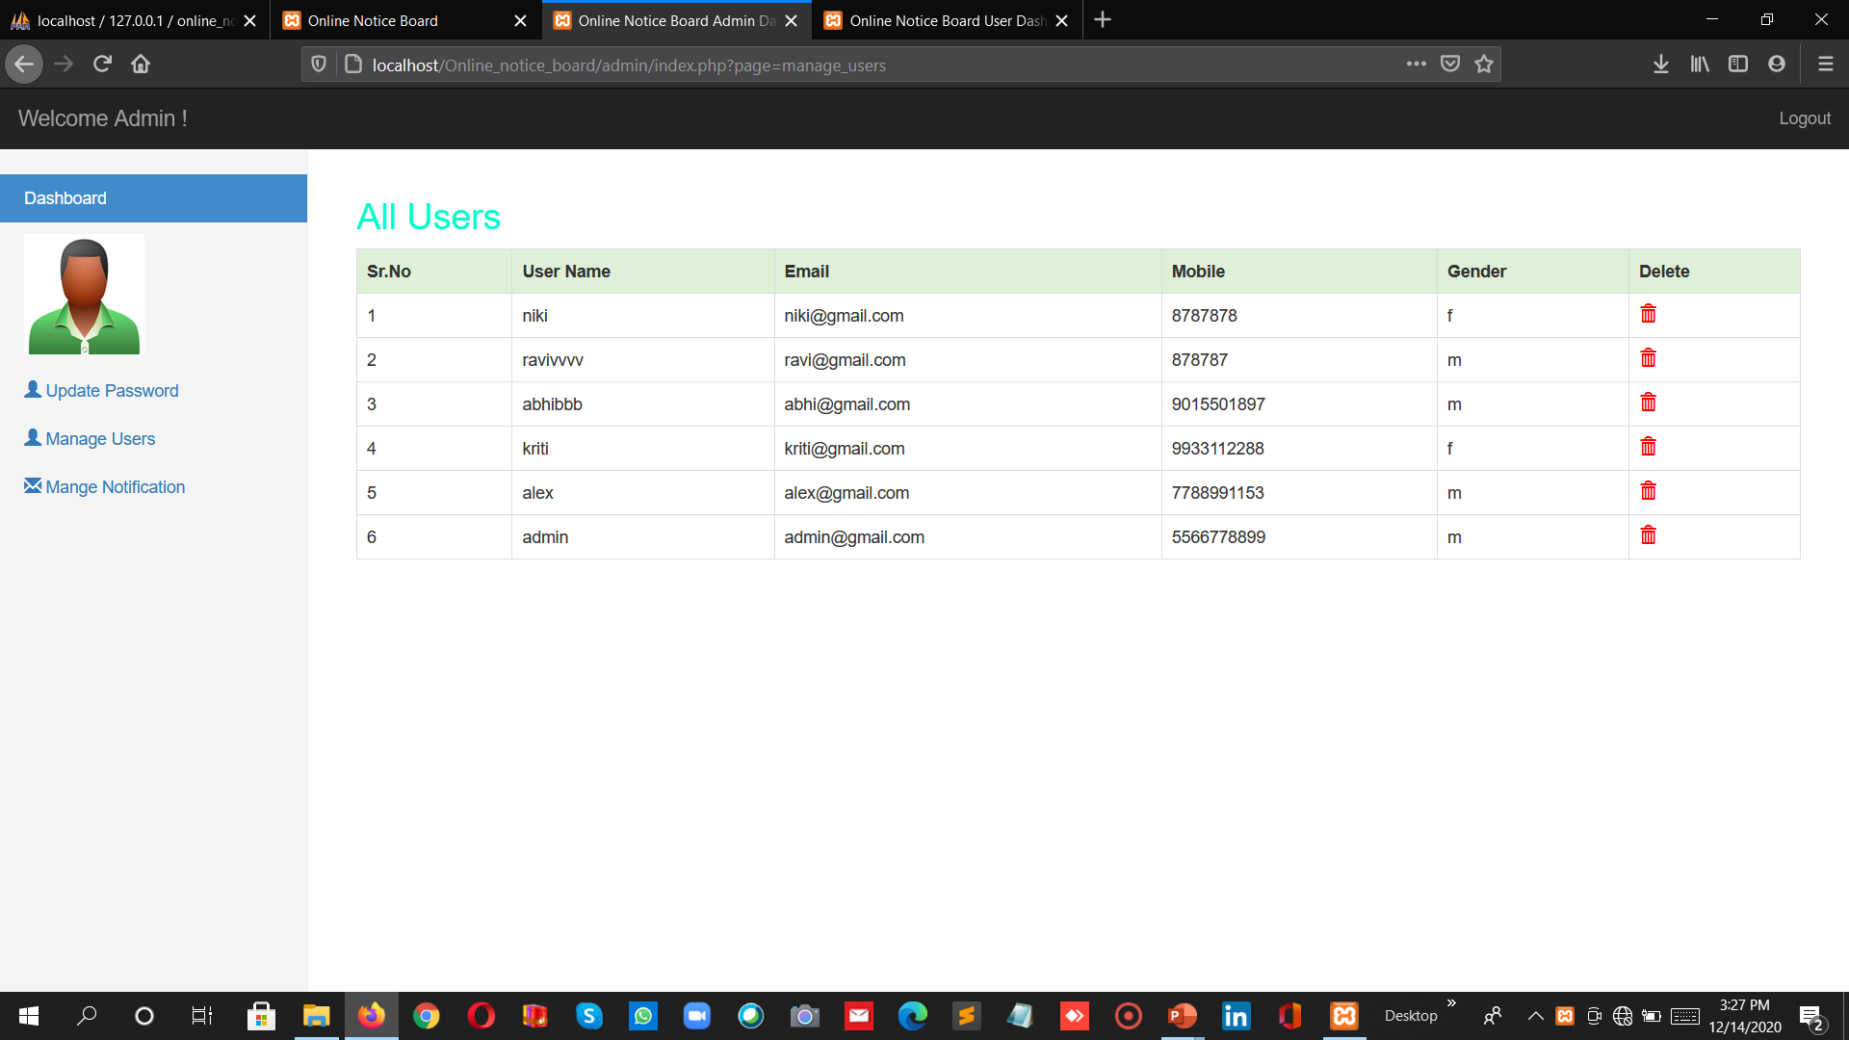
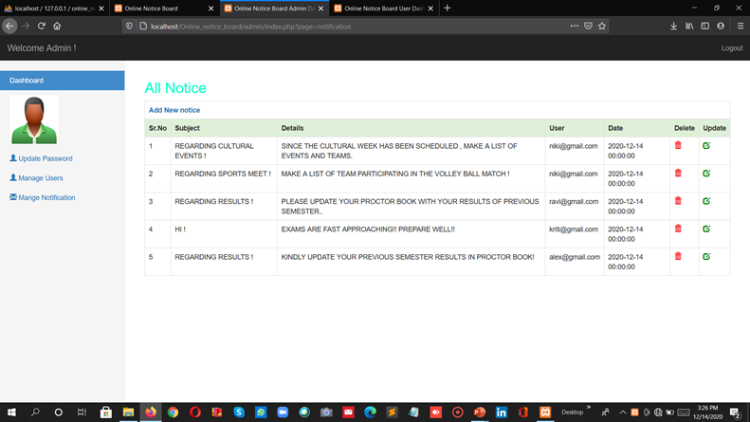
PROJECT SNAPSHOT – ADMIN PANEL
MANGING ALL USERS
MANAGING ALL NOTICES

Slide 16
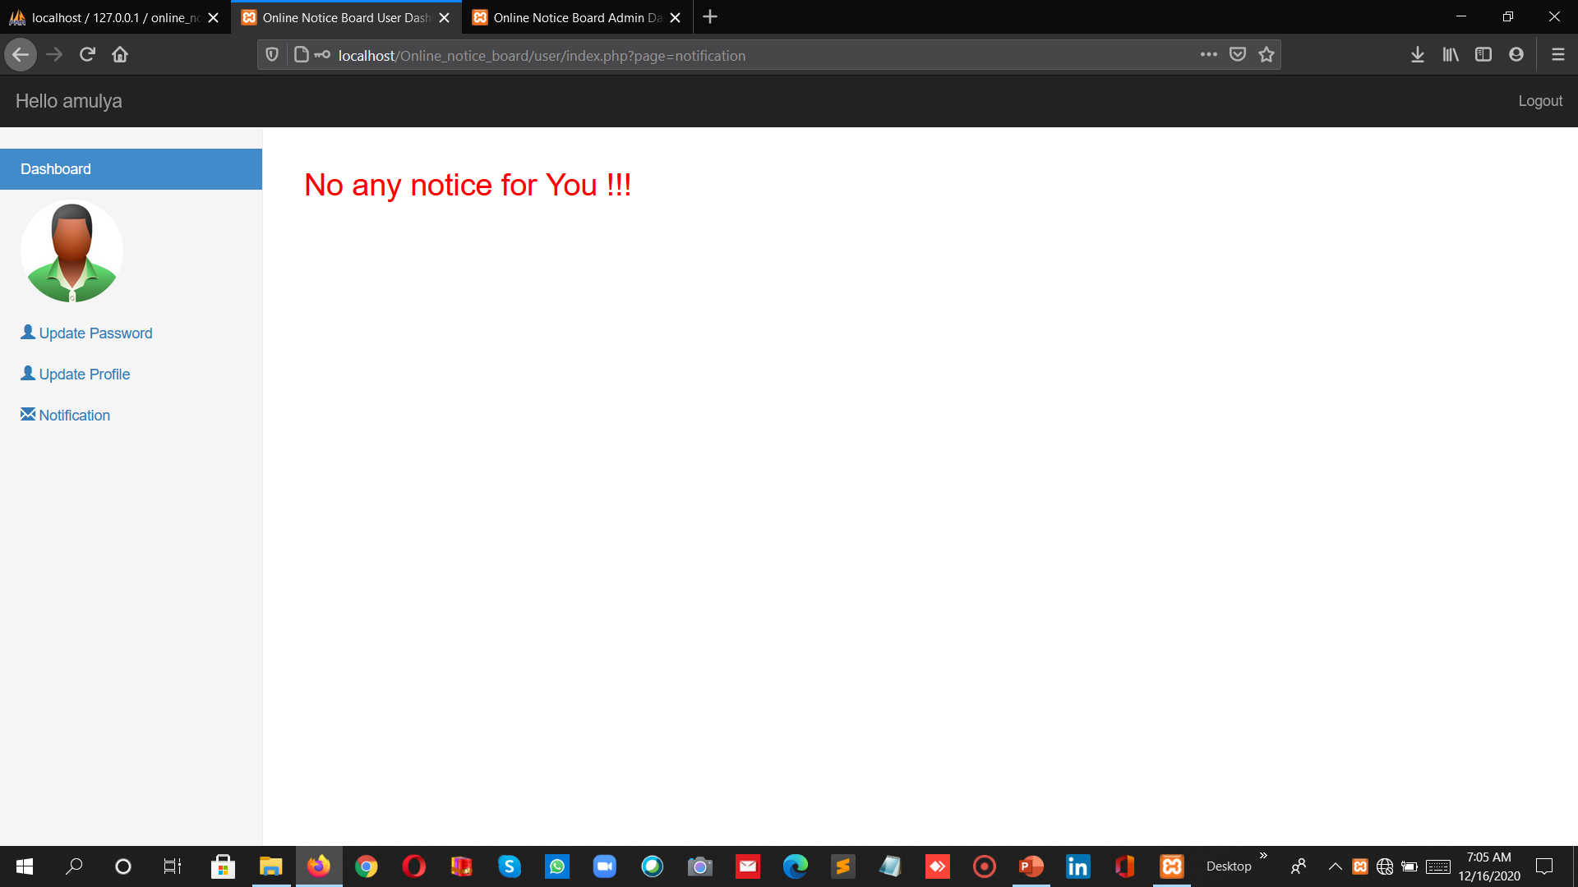
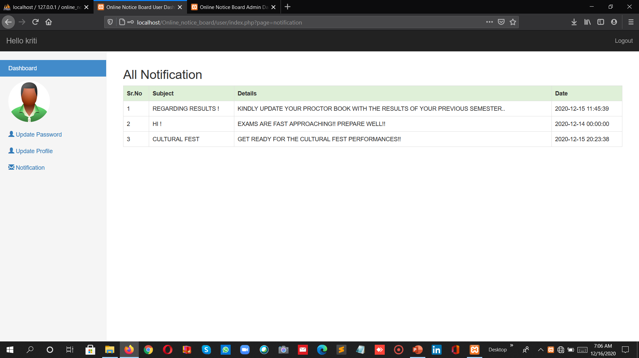
PROJECT SNAPSHOT – USER PANEL
NOTIFICATIONS RECEIVED BY USER

Slide 17

CONCLUSION
The project greatly helped in understanding the phases involved in WEB DEVELOPMENT.
Exposure to various web technologies like HTML , CSS , BOOTSTRAP, PHP.
These valuable skills have boosted our professional skills to a higher level and prepare us for future career.

Slide 18
THANK YOU

